Slide 1

Vehicle Signal
Specification
2016-08-30
Magnus Feuer
Head System Architect | Expert Group Lead
Jaguar Land Rover
This work is licensed under a Creative Commons Attribution-Share Alike 4.0 (CC BY-SA 4.0)
GENIVI is a registered trademark of the GENIVI Alliance in the USA and other countries
Copyright © GENIVI Alliance 2016

Slide 2
The Problem
Vehicle state is being off boarded to Internet services
There is no standard / process that fits the bill
No public forum where changes can be processed in a lightweight manner
One format does not suit all
Decouple IVI from electric architecture
GENIVI is a registered trademark of the GENIVI Alliance in the USA and other countries
Copyright © GENIVI Alliance 2016

Slide 3
VSS - Introduction
Standardizing signal specification
YAML subset
Minimum attributes
Lightweight change process
Single source – multiple targets
Feed other standardization organizations (W3C, etc)
Technically simple
GENIVI is a registered trademark of the GENIVI Alliance in the USA and other countries
Copyright © GENIVI Alliance 2016

Slide 4
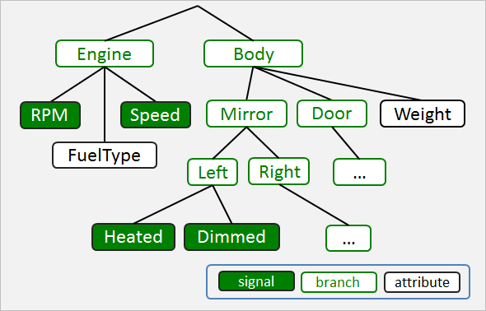
VSS Signal structure

Slide 5
Naming Convention
Body.Mirror.Left.Heated
Body.Mirrors.Right.Heated
Cabin.Door.Row1.left.open
Cabin.Door.Row2.left.open
Dot notated name path
Last component is signal or attribute

Slide 6
Specification source format: Branches
- Transmission:
type: branch description: Transmission-specific data, stopping at the drive shafts.
YAML list
Only type and description mandatory

Slide 7
Specification source format: Signals
- Speed:
type: Uint16
unit: km/h
min: 0
max: 350
description: Vehicle speed
Uses Franca typing
Optional interval
Optional SI unit type
Can be enumerated

Slide 8
Specification source format: Attributes
- Weight:
type: Uint16
unit: kg
default: 1485
description: Vehicle weight
Signal with a default value
Used to describe configuration data

Slide 9
Signal source format
root.vspec
root.vspec
engine.vspec
VSS spec
#include engine.vspec
#include nav.vspec
#include ivi.vspec
nav.vspec
ivi.vspec
Multiple files aggregated together to a uniform specification
YAML-compliant include directives used to aggregate spec fragments
Facilitates git(hub) working model
Minimizes commit conflicts

Slide 10
Spec file re-use
Cabin
door.vspec
Door
- Locked: …
- WinPos: …
- Open: …
Row1
Row2
Right
Left
Right
Left
root.vspec
#include door.vspec Cabin.Door.Row1.Right
#include door.vspec Cabin.Door.Row1.Left
#include door.vspec Cabin.Door.Row2.Right
#include door.vspec Cabin.Door.Row2.Left
Locked
Locked
Locked
Locked
WinPos
WinPos
WinPos
WinPos
Open
Open
Open
Open
YAML-compliant include directives used to aggregate specification fragments
An update to a fragment is propagated to all locations where it is used
Facilitates git(hub) working model

Slide 11
Private Extensions
Private
OEM_X
#include vss_23.vspec
- Private.OEM_X.AntiGravity.Power: …
- Private.OEM_X.TSeleport.TargetLoc: …
…
Body
Engine
AntiGravity
Teleport
IVI
....
oem_x_proprietary.vspec
Power
…
TargetLoc
…
vss_23.vspec
oem_x_proprietary.vspec
A proprietary signal specification can use the GENIVI VSS as a starting point
Can be used in production project to integrate with vendors
Mature private extensions can be submitted for VSS inclusion

Slide 12
Overriding signal definitions
GearChangeMode: enum: [ "auto", "manual" ]
Drivetrain
Drivetrain
vss_23.vspec
Transmission
Transmission
GearChangeMode
enum: [ "auto", "manual" ]
GearChangeMode
enum: [ "auto", "manual", "semi-auto" ]
#include vss_23.vspec
GearChangeMode: enum: [ "auto", "manual", "semi-auto" ]
vss_23.vspec
oem_x_proprietary.vspec
oem_x_proprietary.vspec
Original specification lacks "semi-auto" mode in gearbox.
OEM-specific vspec file can override the original signal and redefine it.

Slide 13
Declaring and Defining Attributes
Chassis.Weight: value: 0
Engine.Displacement value:0
Attribute
Attribute
vss_23.vspec
Engine
Chassis
Engine
Chassis
#include vss_23.vspec
Chassis.Weight: value: 1580
Engine.Displacement value:3198
Displacement
value: 0
Weight:
value:0
Displacement
value: 3198
Weight:
value:1580
vss_23.vspec
oem_x_proprietary.vspec
oem_x_proprietary.vspec
Declaration is done as GENIVI-official VSS attribute with a nil default
Declaration is overridden by definition in OEM/project-specific spec file with correct value

Slide 14
Generating target specifications
Markdown
generator
Markdown
Specification
root.vspec
engine.vspec
FrancaIDL
generator
FrancaIDL
Specification
VSS parser
nav.vspec
JSON
generator
JSON
Specification
ivi.vspec
…
…
Parser loads and interprets specification files
Generators produces target documents and specifications
Targets can be used as input to production projects and other organizations
Additional generators can be added as needed.

Slide 15
Release management
V1
V2
V3
V4
master
develop
PR#1
PR#2
PR#3
PR#4
PR#5
Mail thread
Mail thread
Mail thread
x
Mail thread
Mail thread
Pull requests submitted by anyone
Mail discussion on genivi-projects list to approve request into develop branch
Develop branch merged into master prior to tagged release
Major number changes when existing tree structure is changed

Slide 16
More Info
github.com/PDXostc/vehicle_signal_specification
Demo time

